Slide 1
Solved Examples
Numerical Linear Algebra

Slide 2
Solve the following using gauss elimination

Slide 3
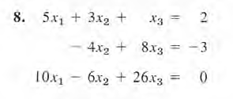

Slide 4
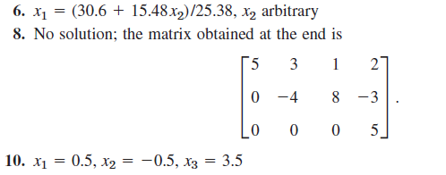

Slide 5
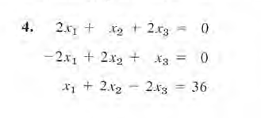
LU factorization

Slide 6
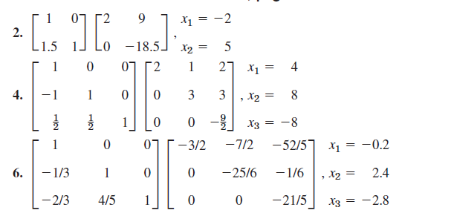

Slide 7
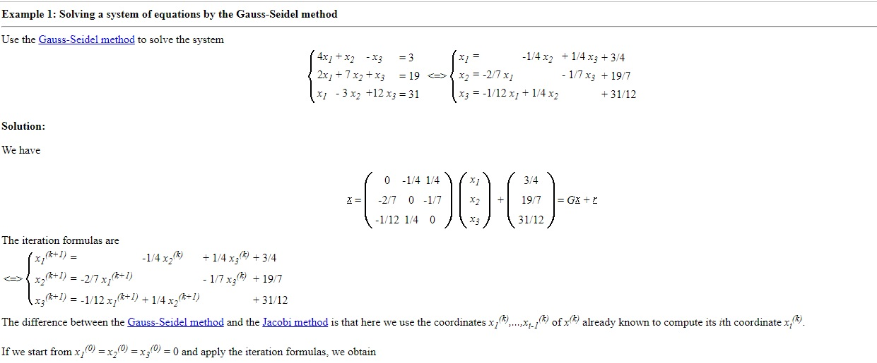
Gauss Siedel elimination

Slide 8
